Slide 1
Web Foundations
Code Value boot camp

Slide 2
React

Slide 3

Introduction
React is a frontend JavaScript library.
React was developed by the Facebook.
React is a tool for building UI components.

Slide 4
How does React Work?
React creates a VIRTUAL DOM in memory
Instead of manipulating the browser's DOM directly, React creates a virtual DOM in memory, where it does all the necessary manipulating, before making the changes in the browser DOM.
React only changes what needs to be changed
React finds out what changes have been made, and changes only what needs to be changed.

Slide 5
Setting up a React Environment
Install Node.js and npm
Open VS Code
Create a new folder for your project
Open the terminal
Run the following command:
npm create vite@latest

Slide 6
About Node.js
Node.js is a free, open-source, cross-platform JavaScript runtime environment that allows developers to run JavaScript code outside of a web browser.
It enables server-side development and networking applications using a language previously limited to the client-side browser environment.

Slide 7
Why do we need Node.js & Vite?
⚙️ NODE.JS
⚡ VITE
📦
Package Manager (npm)
⚡
Instant Dev Server Start
Installs React, libraries & tools via npm. Without Node.js, there's no npm.
Uses native ES modules — server starts in milliseconds, not seconds.
🔧
Runs Build Tooling
🔥
Hot Module Replacement
Vite, Babel & Webpack all run on Node.js. It's the engine behind the scenes.
Changes reflect in the browser instantly without losing component state.
🔄
Transforms JSX → JS
📦
Optimized Production Build
Browsers can't read JSX. Node.js-powered tools compile it to plain JavaScript.
Bundles & tree-shakes code via Rollup for the smallest possible output.
🌐
Local Dev Server
🧩
Zero Config Setup
Serves your app at localhost so you can preview it in the browser instantly.
Works out-of-the-box with React, TypeScript & CSS modules. No boilerplate.

Slide 8
Understanding the Project Structure
📁 my-app/
├── 📁 node_modules/
├── 📁 public/
📄 Entry HTML file loaded by the browser
│ └── index.html
├── 📁 src/
🧩 Root component — starts your app tree
│ ├── App.jsx
🎨 Scoped styles per component
│ ├── App.css
🚀 Mounts React app into the DOM
│ └── main.jsx
├── .gitignore
📋 Dependencies & scripts config
├── package.json
⚙️ Vite build & dev server config
└── vite.config.js

Slide 9
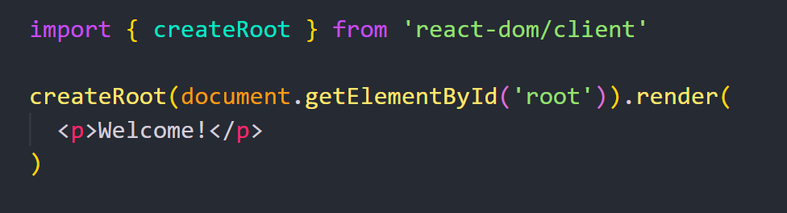
React Render HTML
React's goal is in many ways to render HTML in a web page.
React renders HTML to the web page via a container, and a function called createRoot().

Slide 10
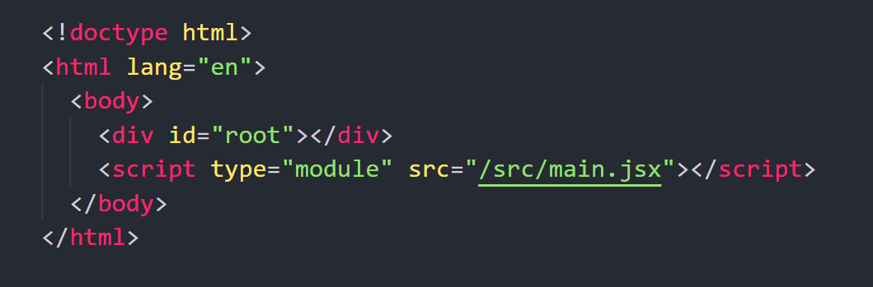
The render Method
The render method defines what to render in the HTML container.
The result is displayed in the <div id="root"> element.

Slide 11
React JSX

Slide 12
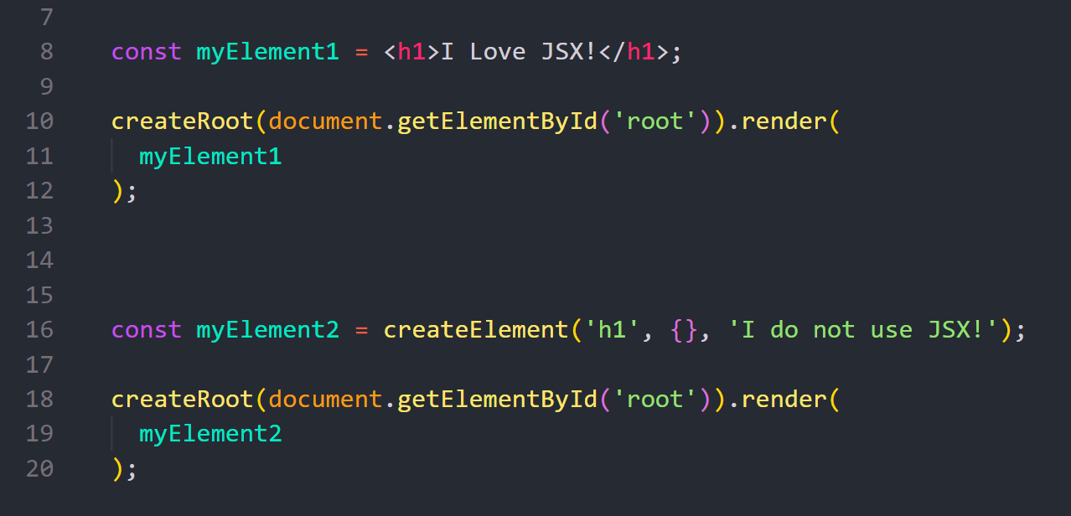
What is JSX?
JSX stands for JavaScript XML.
JSX allows us to write HTML in React.
JSX makes it easier to write and add HTML in React.
JSX is an extension of the JavaScript language and is translated into regular JavaScript at runtime.

Slide 13
Expressions in JSX
With JSX you can write expressions inside curly braces { }.
The expression can be a React variable, or property, or any other valid JavaScript expression.

Slide 14
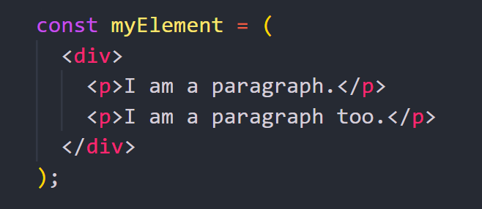
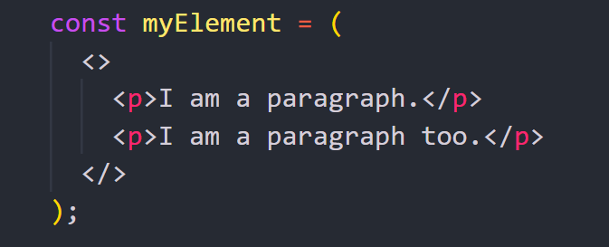
One Top Level Element
The HTML code must be wrapped in ONE top level element.
Alternatively, you can use a "fragment" to wrap multiple lines <></>

Slide 15
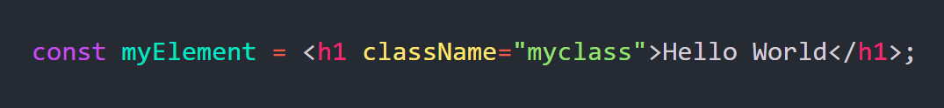
Attribute class = className
The class attribute is a much used attribute in HTML.
Since JSX is rendered as JavaScript, and the class keyword is a reserved in JavaScript, you are not allowed to use it in JSX.
JSX solved this by using className instead.

Slide 16
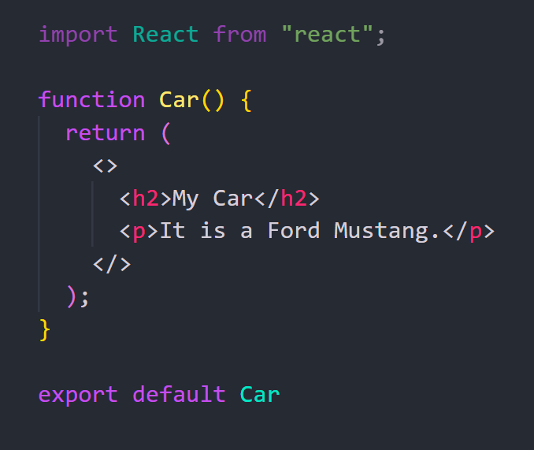
JSX in React Components
React uses components to build UIs.
Components are independent and reusable bits of code.
React components are like JavaScript functions, and return HTML.

Slide 17
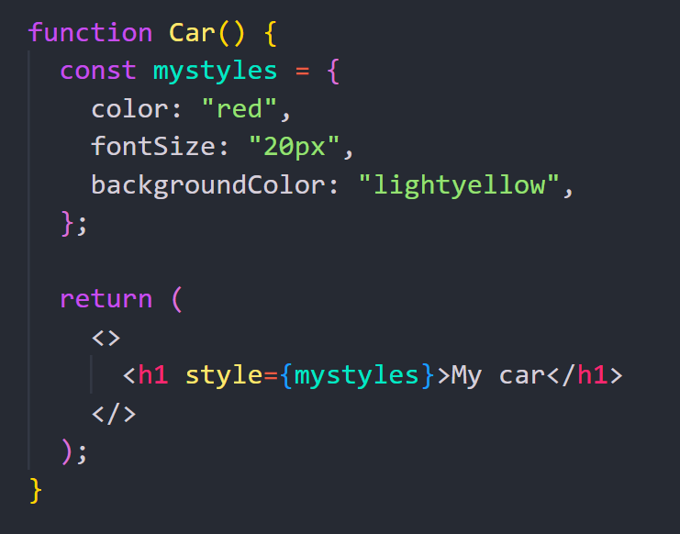
The style Attribute
The style attribute in JSX only accepts a JavaScript object with camelCased CSS property names, rather than a CSS string (as in HTML).

Slide 18
React Components

Slide 19
React Components
React components are:
Reusable, independent pieces of UI code
Similar to JavaScript functions that return HTML
Two types: Class and Function components
We will focus on Function components

Slide 20
Create Your First Component
When creating a React component, the component's name MUST start with an uppercase letter.
React components returns HTML code.

Slide 21
Importing and Exporting Components
It often makes sense to split components into different files.
Make a new JS file to put the components in.
Export your function component from that file
Import it in the file where you’ll use the component
A file can have only one default export.
A file can have many named exports.

Slide 22
Rendering a Component
To use this component in your application, refer to it like this: <Car />
Display the Car component in the "root" element:

Slide 23
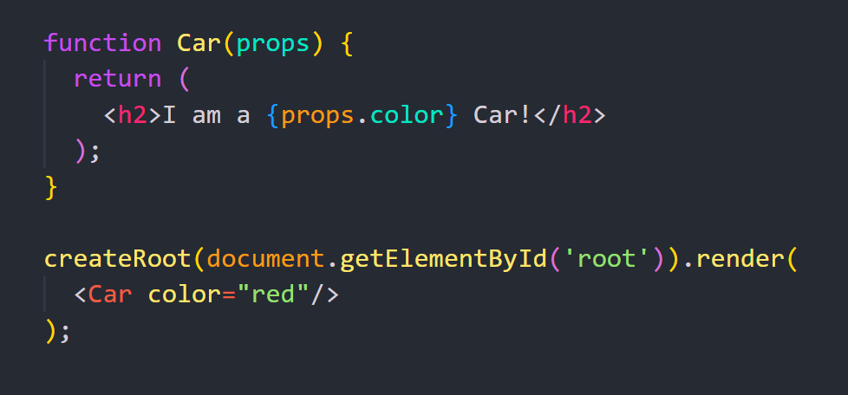
Props
Arguments can be passed into a component as props, which stands for properties.
You send the arguments into the component as HTML attributes.

Slide 24
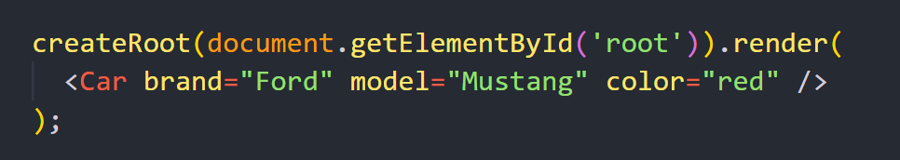
Pass Multiple Properties
You can send as many properties as you want.
Every attribute is sent to the Car component as object properties.

Slide 25
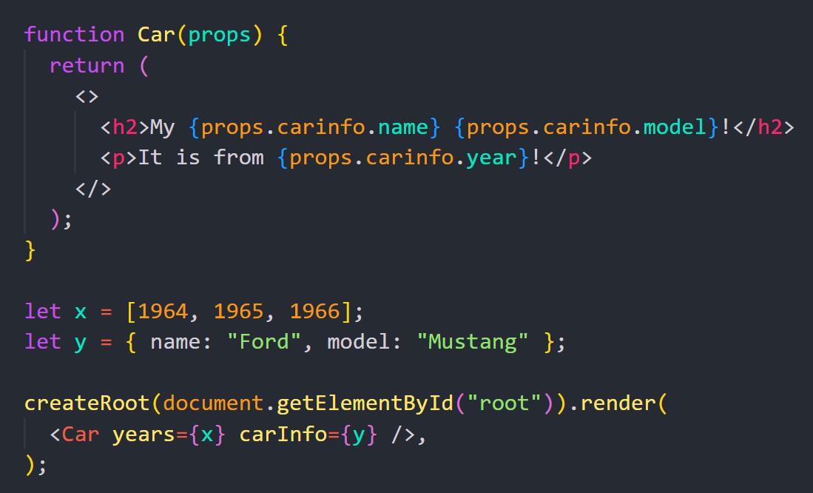
Different Data Types
Props in React can hold any data type: strings, numbers, variables, objects, arrays, etc.
Strings are passed in quotes: "text"
Numbers, variables, and objects are passed in curly braces: {value}

Slide 26
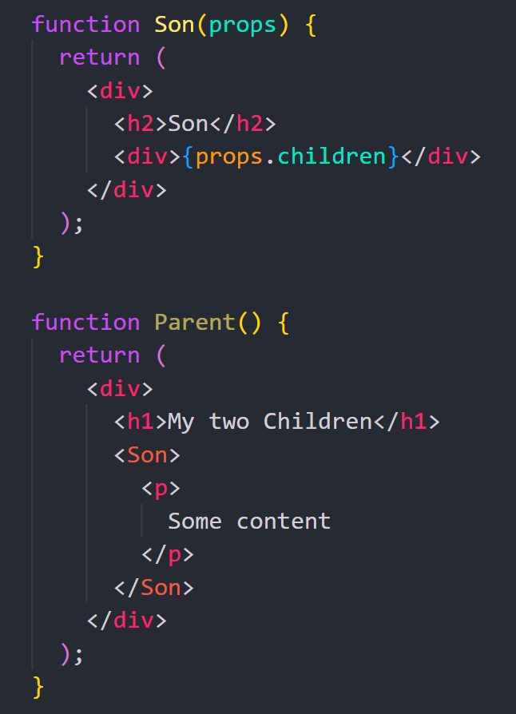
React Props Children
You can pass content placed between a component’s opening and closing tags to another component.
This inner content is available in the receiving component via props.children.

Slide 27
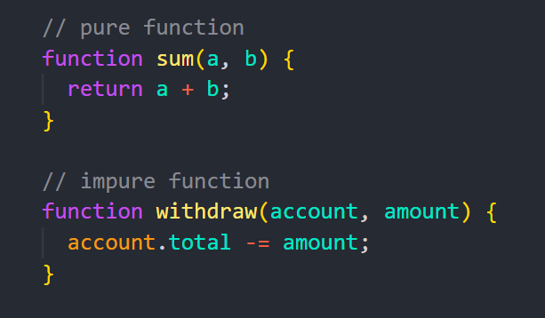
Props are Read-Only
Whether you declare a component as a function or a class, it must never modify its own props.
All React components must act like pure functions
“pure” functions do not attempt to change their inputs, and always return the same result for the same inputs.

Slide 28
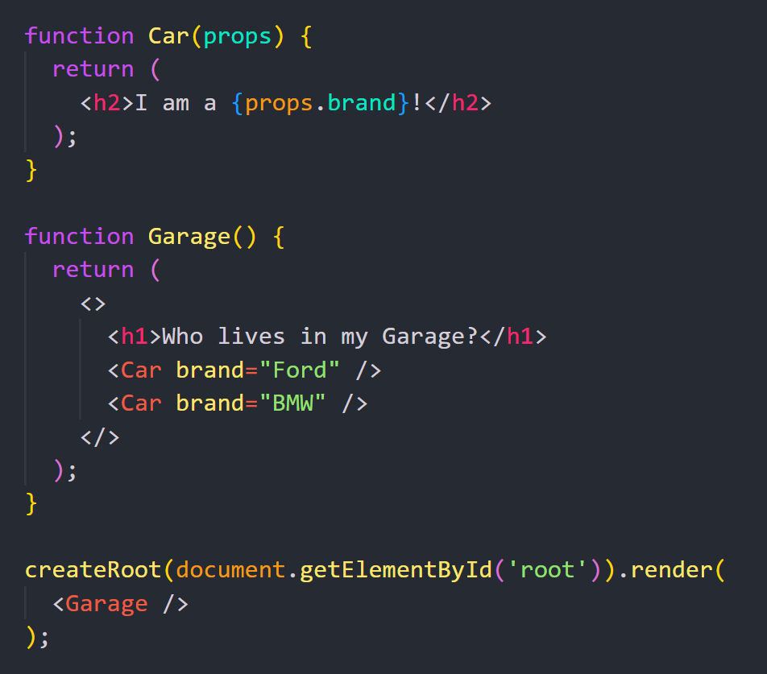
Components in Components
We can refer to components inside other components.
A good practice in React is to place each component in its own file.

Slide 29
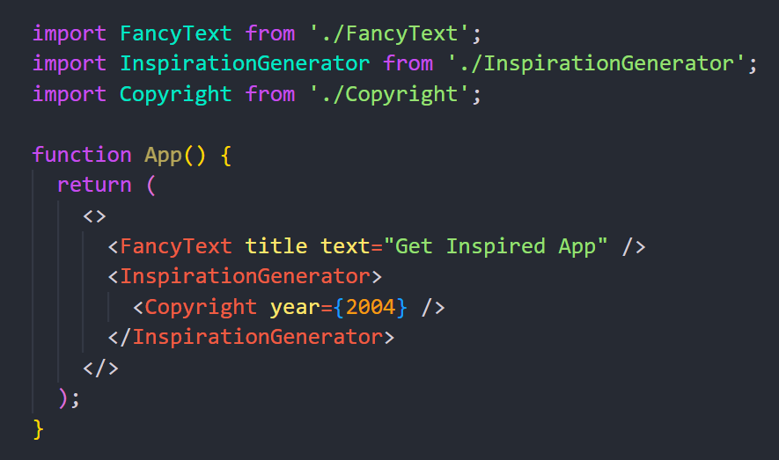
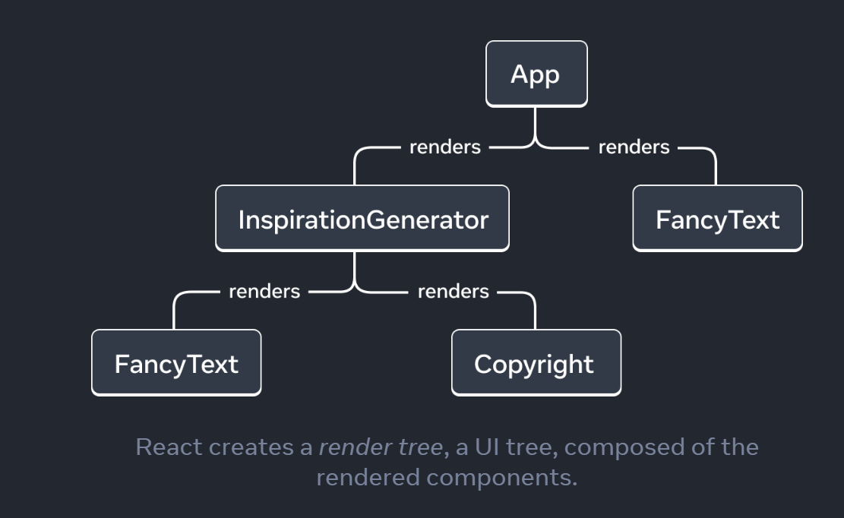
The Render Tree
React creates a render tree, a UI tree, composed of the rendered components.

Slide 30
React Events

Slide 31
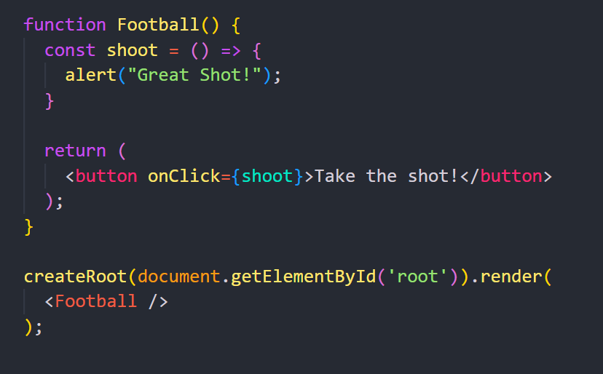
Adding Events
Just like HTML DOM events, React can perform actions based on user events.
React has the same events as HTML: click, change, mouseover etc.
React events are written in camelCase syntax:
onClick instead of onclick.

Slide 32
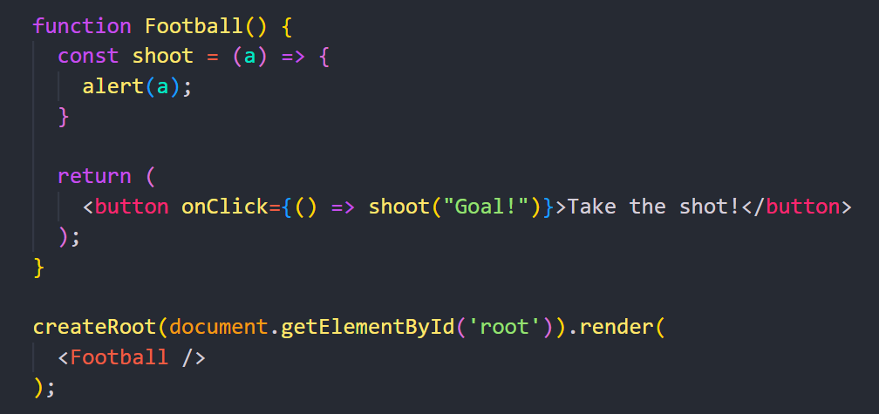
Passing Arguments
To pass an argument to an event handler, use an arrow function.

Slide 33
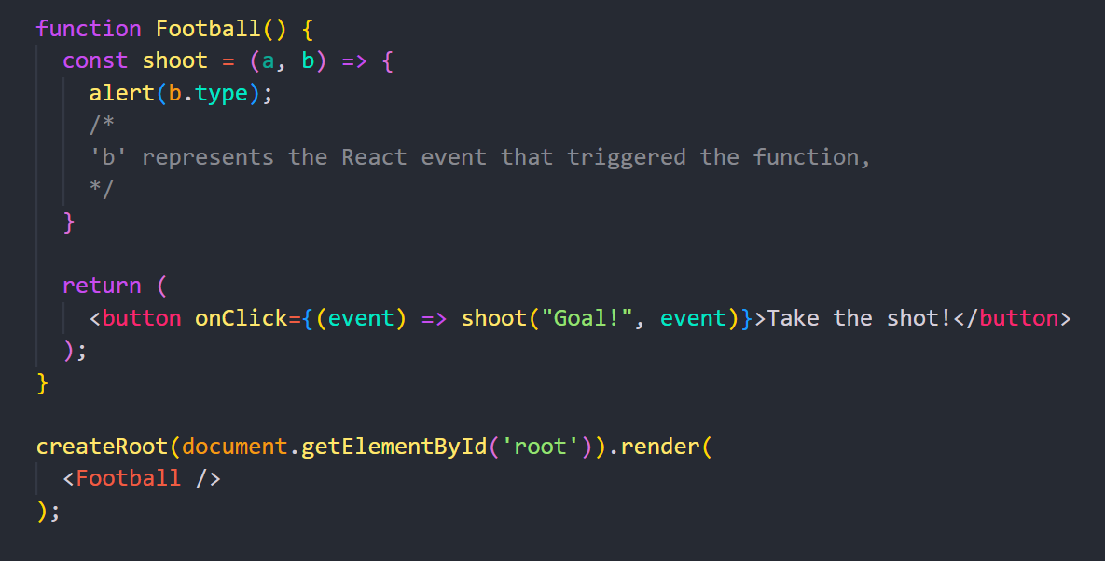
React Event Object
Event handlers have access to the React event that triggered the function.
In our example the event is the "click" event.

Slide 34
React Conditional Rendering

Slide 35
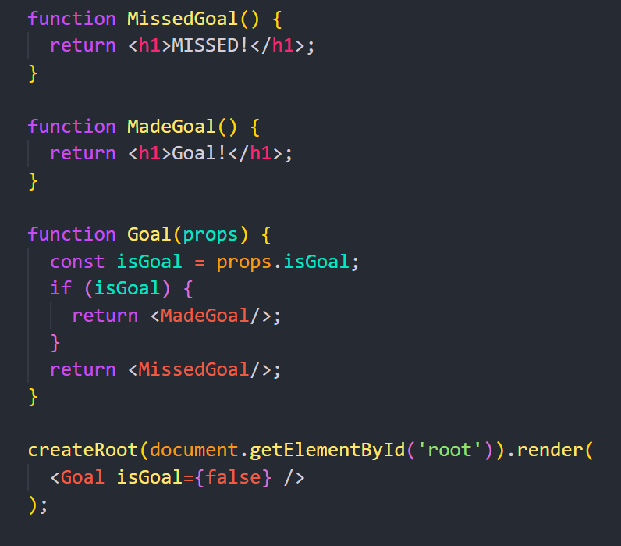
if Statement
We can use the if JavaScript operator to decide which component to render.

Slide 36
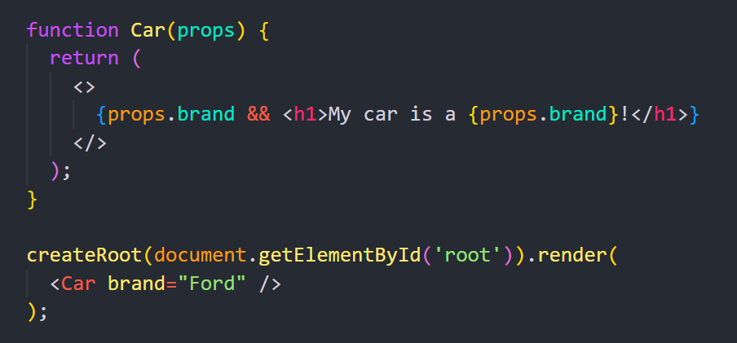
Logical && Operator
The right side of && will only be rendered if the left side is true.

Slide 37
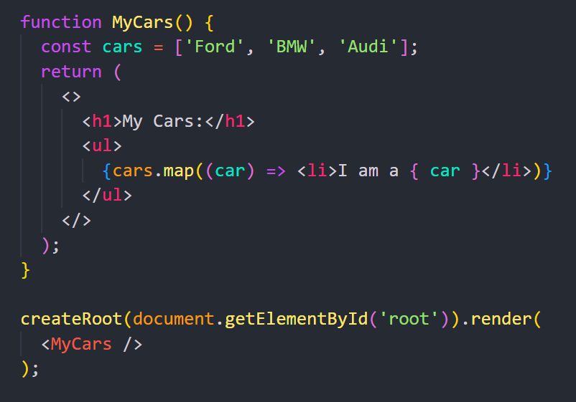
React Lists
In React, you will render lists with some type of loop.
The JavaScript map() array method is generally the preferred method.

Slide 38
React State

Slide 39
A component’s memory
Components often need to update UI after interactions (events).
They must “remember” data like:
Input values
Current image
Shopping cart items
This component-specific memory is called state.

Slide 40
useState Hook
State is added using the useState Hook.
Hooks are special functions that enable React features in components.
useState(initialValue) returns:
Current state value
Setter function to update it
Updating state → React re-renders the component with new UI.

Slide 41
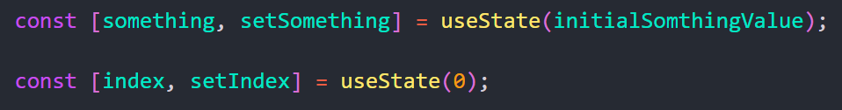
useState Hook
index is a state variable and setIndex is the setter function.
The [ and ] syntax here is called array destructuring and it lets you read values from an array.
The array returned by useState always has exactly two items.

Slide 42
About React Hooks
Hooks are special functions that let you use React features.
Allow logic reuse via custom Hooks.
Call Hooks only at the top level (not inside loops/conditions/functions).
Call Hooks only in React components or other Hooks.
Hook names always start with use.

Slide 43
About React Hooks
Hooks are special functions that let you use React features.
Allow logic reuse via custom Hooks.
Call Hooks only at the top level (not inside loops/conditions/functions).
Call Hooks only in React components or other Hooks.
Hook names always start with use.

Slide 44
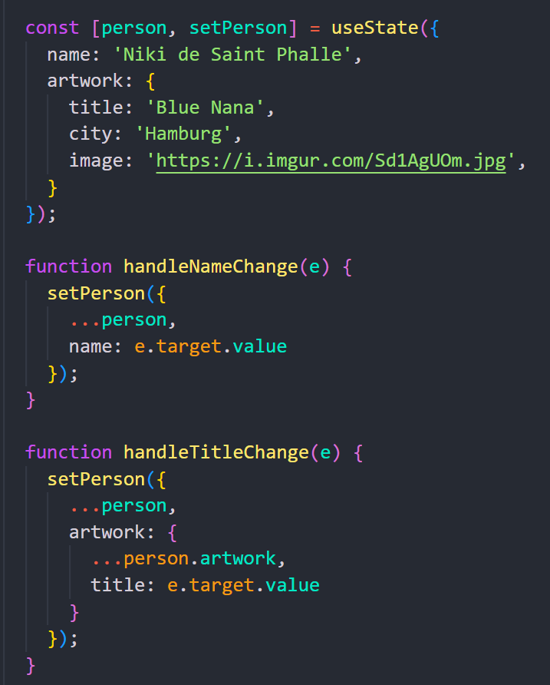
Updating objects in state
State is Immutable
State can hold any JavaScript value, including objects and arrays.
Do not modify objects or arrays in state directly.
To update, create a new copy (or copy and modify).
Use the spread syntax (...) to copy objects or arrays before updating.

Slide 45
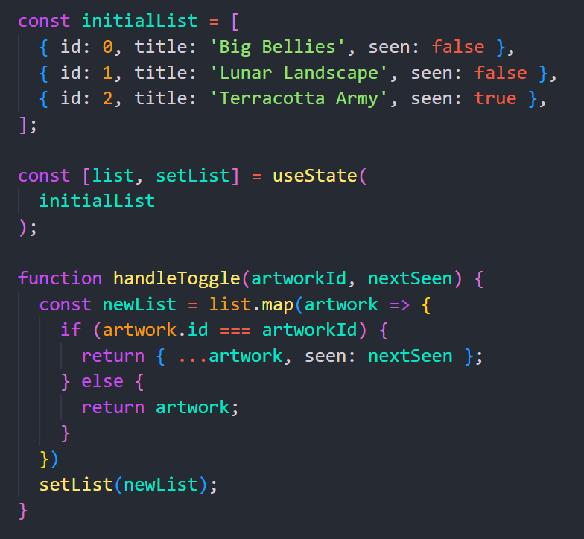
Updating arrays in state
Arrays are mutable, but treat them as read-only in state.
To update an array in state:
Create a new array or copy the existing one.
Set state to the new array.
This preserves immutability and ensures proper re-rendering.

